Slide 1
Sponsorship Opportunities

Slide 2
National Indoor Cricket League (NICL)
The National Indoor Cricket League is a National Centre/Club based competition creating a clear and attractive player pathway leading to better quality players and more people playing the game. 2020 represents the fourth year of this national competition.
ISC Teamwear are the official apparel supplier of the competition, kitting out all teams in their playing apparel for the 2020 season.
Teams will use Burley Sekem indoor cricket balls during matches, and play under consistent match rules and regulations across the country.
Key Highlights
Over 75 teams & 1000 participants across Australia playing regular matches between April and August.
15 competition Zones (both men’s and women’s divisions).
Over 400 games played, including 60 live streamed games.
Games hosted across 32 indoor sports centres around the country.
Weekly live stream coverage on a Sunday evening from late April to mid-August via the Cricket Australia Indoor Cricket Facebook page.
A National Finals Series bringing together the winning team from each Zone vying for the best team in the country.
Several current BBL and WBBL players competing in the NICL competition including Clive Rose, Clint Hinchcliffe, Kara Sutherland, Tegan McPharlin and Carly Leeson.

Slide 3
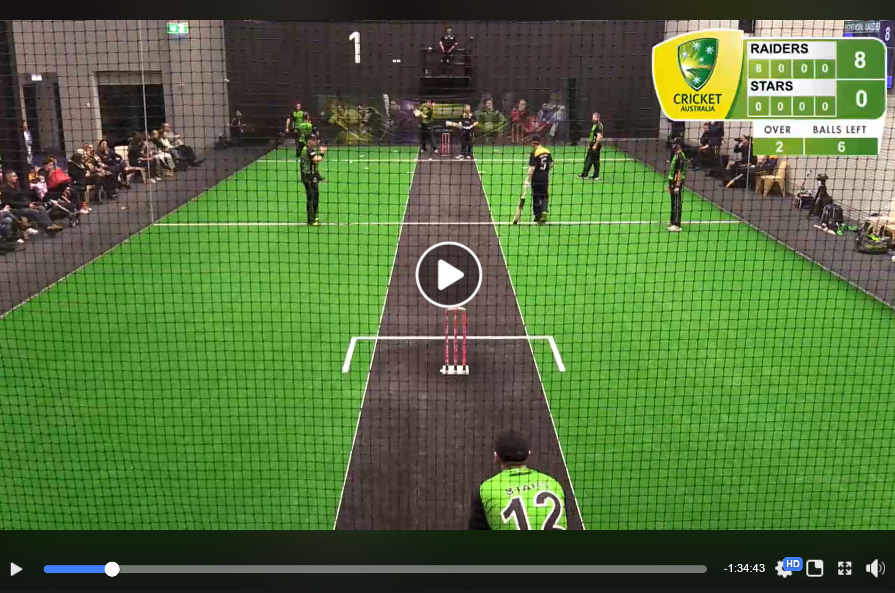
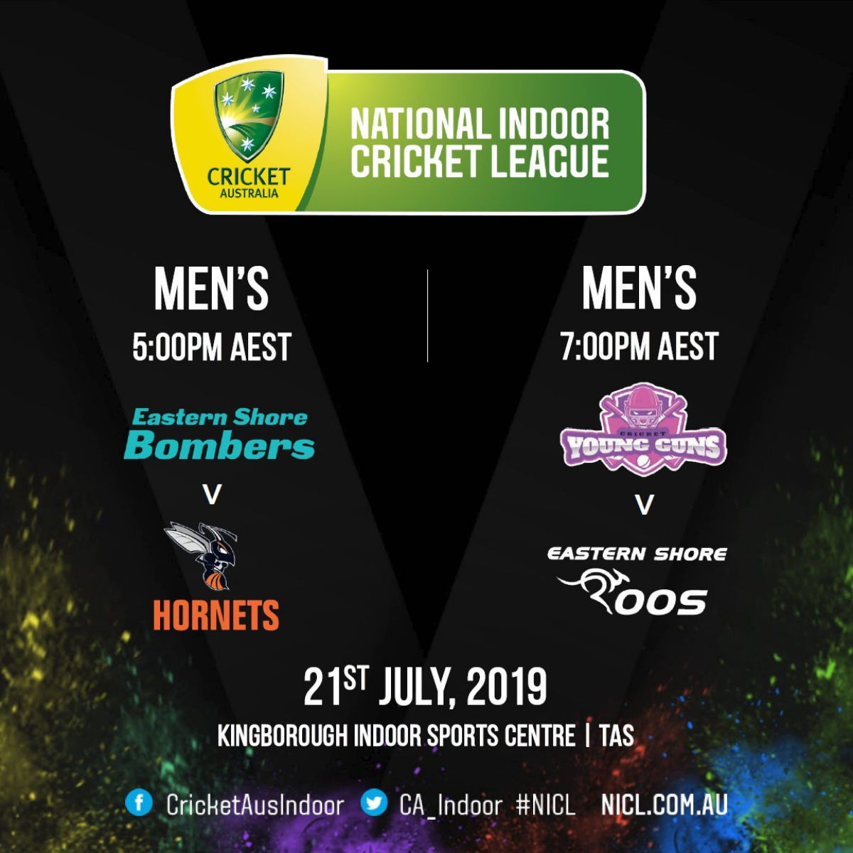
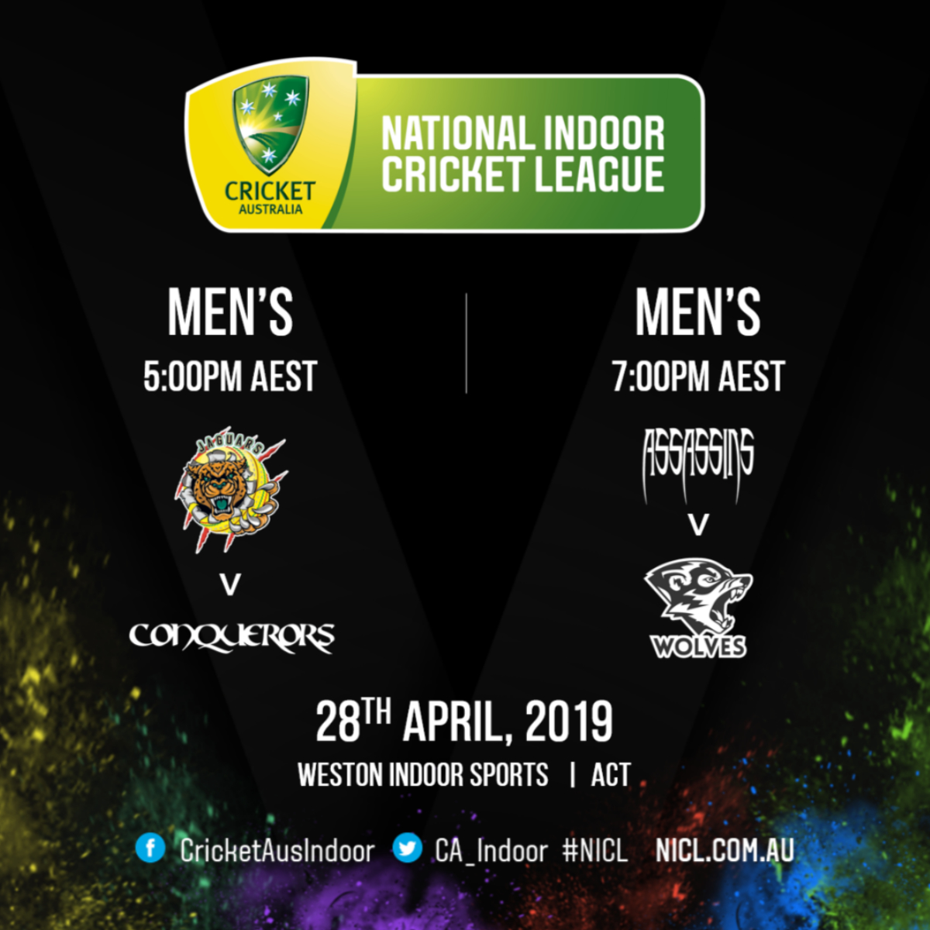
Sponsorship Reach
Live Streamed Games
Average of 1 million video views across the competition period each year, with an average of over 14000 views for every streamed weekend across Facebook.
Marketing Collateral
Social media assets shared weekly to the Cricket Australia Indoor Facebook page with over 35k followers.
Website
Over 20K page views of the NICL website between April - September 2019.

Slide 4
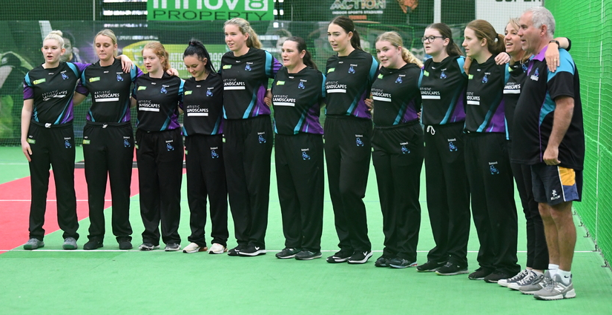
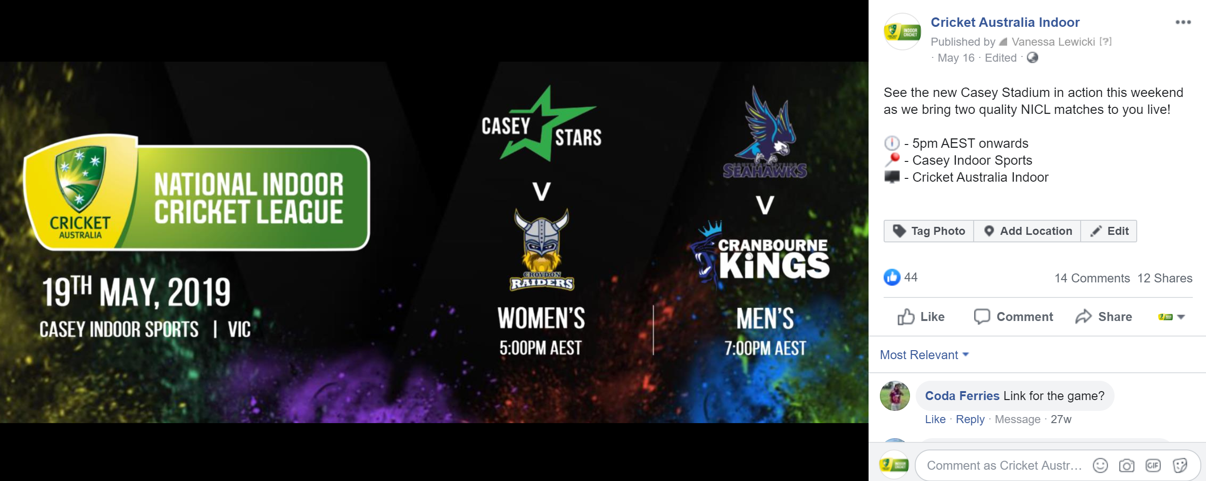
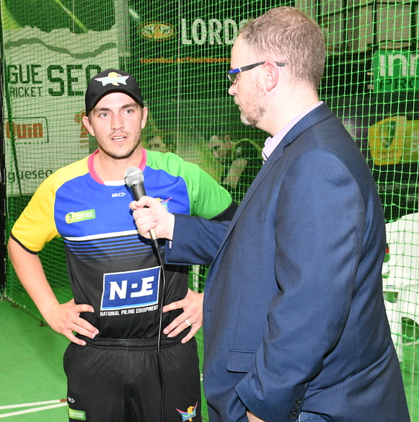
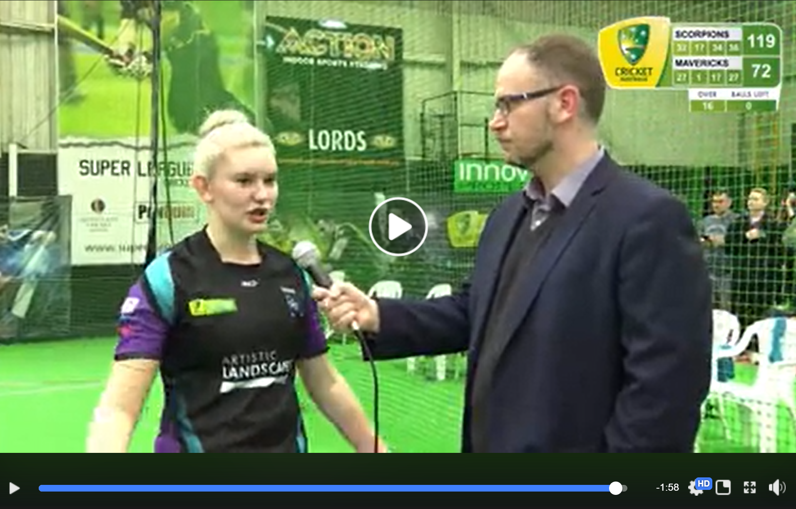
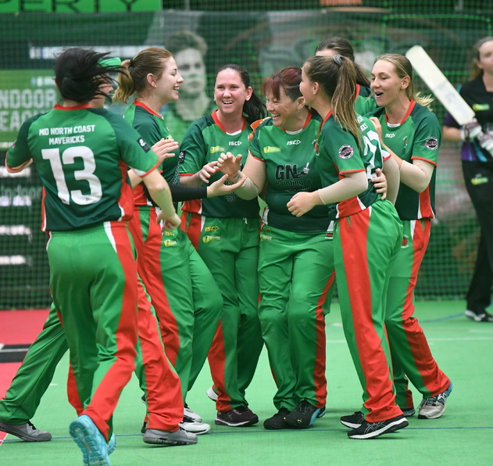
Sponsor Recognition

Slide 5
Sponsorship Levels – TEAM
The terms of any formal sponsorship agreement are negotiable, depending on the level of sponsorship offered and the nature of the sponsorship (financial or in-kind). However, the below levels of sponsorship are indicative of arrangements that could be negotiated.
MINOR PARTNER: $100 – $500
MAJOR PARTER: $1,500
Sponsor logo on sleeve of Team’s Playing Shirt. Each Zone (competition area) will have a minimum of one live streamed match on the CA Indoor Facebook page and the competition website.
Sponsor logo and brief description of business on the Team’s Profile Page, accessed via the competition website. Logo will link to the sponsor’s website or social media page.
Sponsor logo in various locations on off-court team apparel. Teams have the ability to design and purchase a range of off-field team apparel.
Sponsor logo in a prominent position on the front of the Team’s Playing Shirt. Zone (competition area) will have a minimum of one live streamed match on the CA Indoor Facebook page and the competition website.
Naming Rights partner of the designated NICL Team. (e.g. Bunting’s Lara Tigers)
Sponsor logo in various locations on off-court team apparel. Teams have the ability to design and purchase a range of off-field team apparel.
Signage at home matches for viewing by patrons at the match, those who view photos taken at the match and shared via social media, and those watching any live streaming coverage.
Live streaming call out of partner recognition from commentators and/or interviews during the broadcast (should the team appear on the live stream).
N.B. Should the team win the Zone Title, the sponsor will receive significant sponsorship recognition throughout the live streaming of the NICL National Finals Series.
NICL teams will be required to seek approval from Cricket Australia (CA) for any sponsors to ensure that the local sponsorship does not conflict with existing CA sponsors and partners.

